Slide 1

WEB SCRAPING PROJECT
The Impact of Central Bank Policy Rate on Bond and Stock Investors

Slide 2

CONTENT
Motivation
Objectives
Data Collection
Methodology
Analysis
Findings
Correlation Analysis
Conclusion
Challenges and Next steps

Slide 3

MOTIVATION
Understanding the relationship between the central bank’s policy rate, and investment activity, to confirm whether or not the stock market was influenced by the policy rate.
Notes:
In today’s economic climate, understanding the dynamic interplay between the central bank’s policy rates, and investment activity Short-term benchmark bond yields, and stock market index is essential to understanding how investors operate
Within financial markets and the impact on the broader economy. Stock markets are known to be sensitive to unexpected changes in monetary policy and given that the Canadian economy has entered a recession we wanted to track the macroeconomic variables to ascertain whether they moved with expectation and how investors can benefit from this business cycle.
To analyse the times series data over a ten (10) year period to observe the impact of monetary policy.
To understand the implications of these relationships and the broader economy.
Central banks use monetary policy to manage economic fluctuations and achieve price stability, which means that inflation is low and stable. Central banks in many advanced economies set explicit inflation targets.

Slide 4

DEFINITIONS
Policy Rate: The primary interest rate set by the Bank of Canada which all Banks and financial institutions use as their guiding light to set their individual deposit/loan interest rates.
2 year Benchmark Bond Yields: This is the short term government bond(a contract indicating a loan between the government and an investor i.e: bank, company, citizen) interest rates that are drawn to represent the forecast for the economic growth of a 2 year period.
Composite Stock Index: A grouping of stocks in a standardized way. It is a tool to measure the overall performance of the stock market.
Notes:
curve: the forecast for the economic growth
government bond: a contract between an investor(bank, company, individual citizen) and the government indicating repayment after two years of both the initial payment, and interest(a.k.a a loan)
coupon rate: the interest rate on the government bond

Slide 5
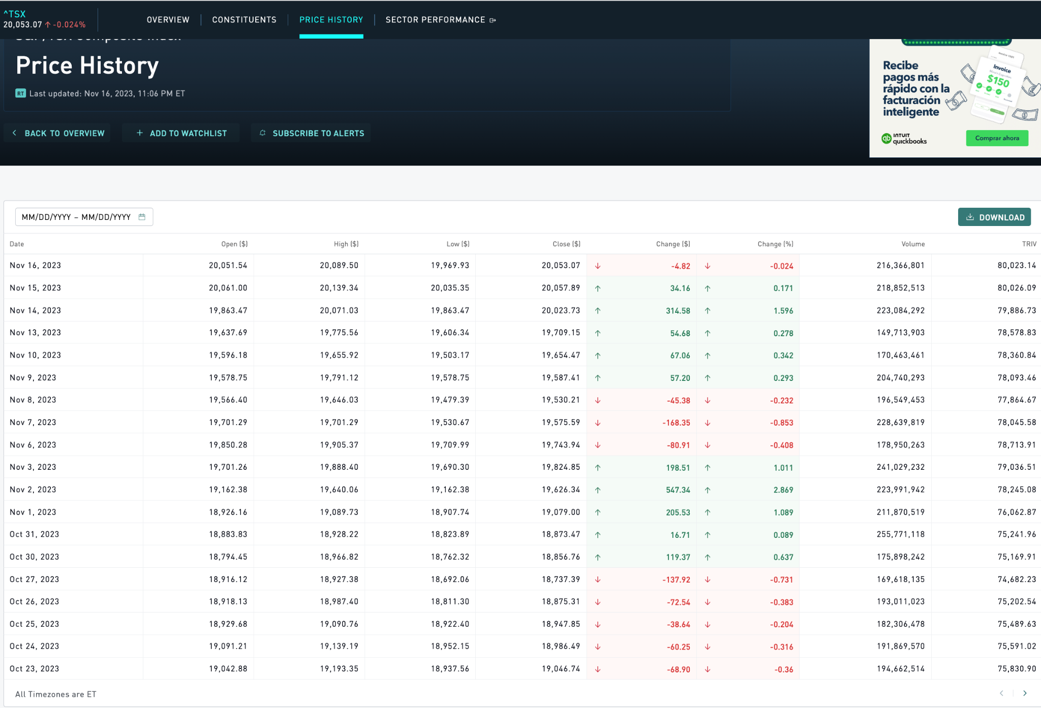
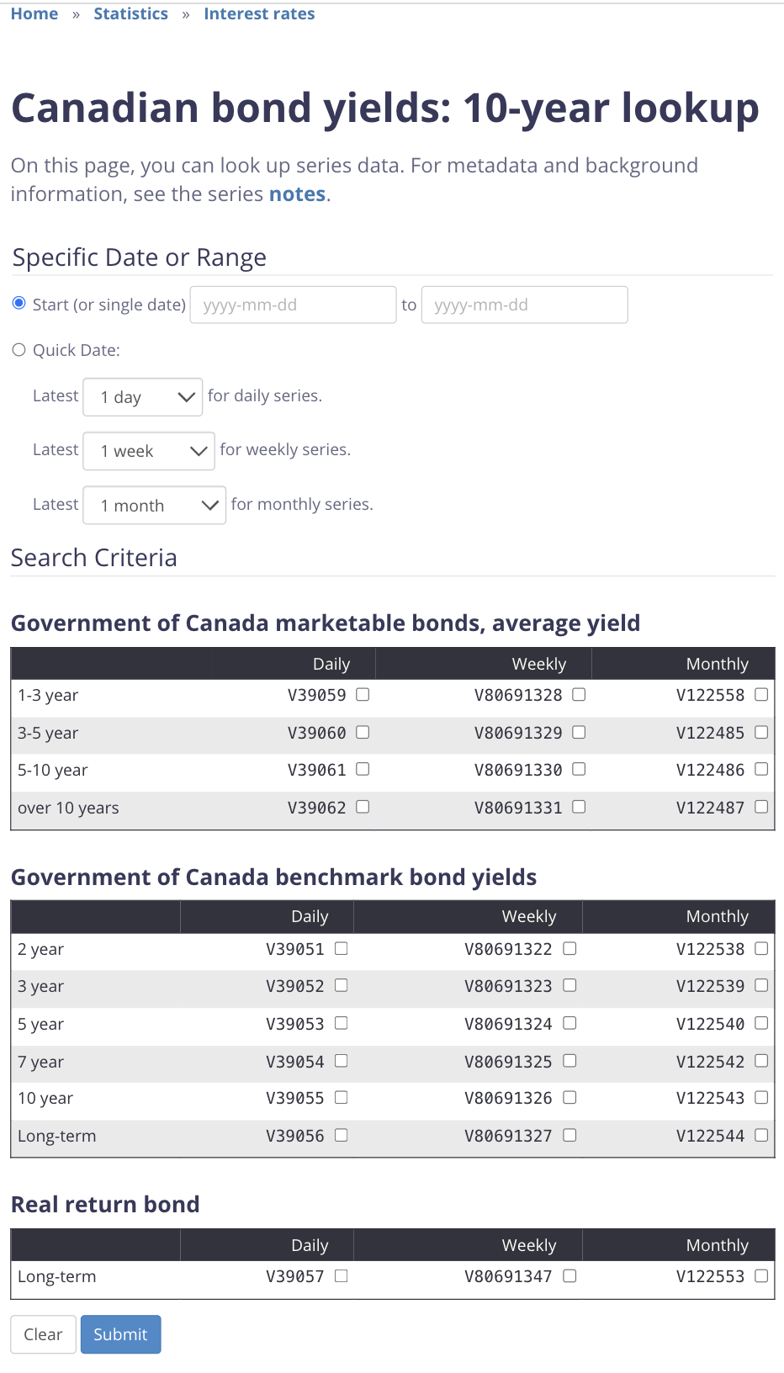
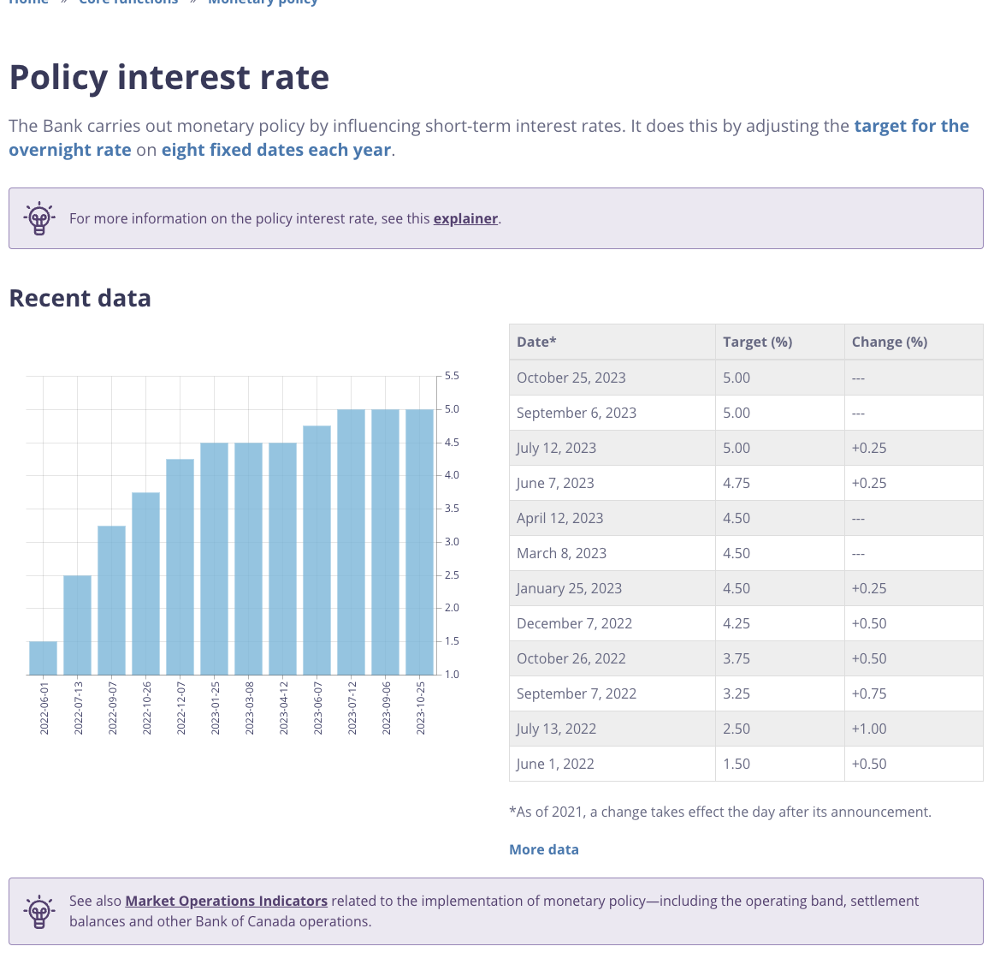
DATA COLLECTION
3 times Series data:
Stock Market Index
Bank of Canada Policy rate
2-Year Benchmark bond yields
2 websites:
Bank of Canada
TMX Money
Form: Table after defining search criteria
Tool : Selenium
Notes:
We gather three time series through web scraping technique
The Stock Market Index data: we will scrape monthly index data from the Toronto Stock Exchange (TSX).
This data will provide insights into stock market performance
Bank of Canada Policy rates: we will extract monthly policy rates from the bank’s website via web scraping.
This data will provide insights into the performance of the economy over cycles.
2-Year Benchmark bond yields: Our web scraping will also include short-term bond yields. This information
is crucial in understanding the impact of monetary policy on the yield curve.

Slide 6
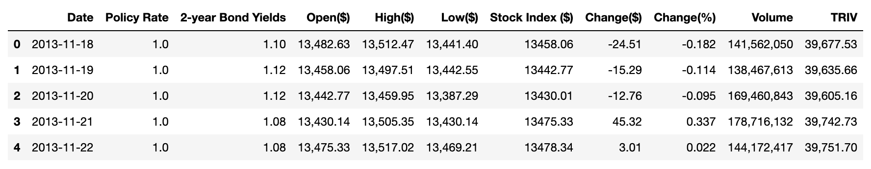
METHODOLOGY
NAVIGATING THE PAGE
SCRAPING
DATA PREPROCESSING
ANALYSIS
Navigating through the page to reach the database location
Defining the time period and the search criterias ( targeted data)
Identifying the table element
Iterate through the rows and columns elements to get the text of each cell
Results : Three dataframes with 2500 to 2600 records each merged into one
Data Cleaning: Removing duplicates, converting data types, dropping ‘null values’
Preparing Data Visualizations to gather insights

Slide 7
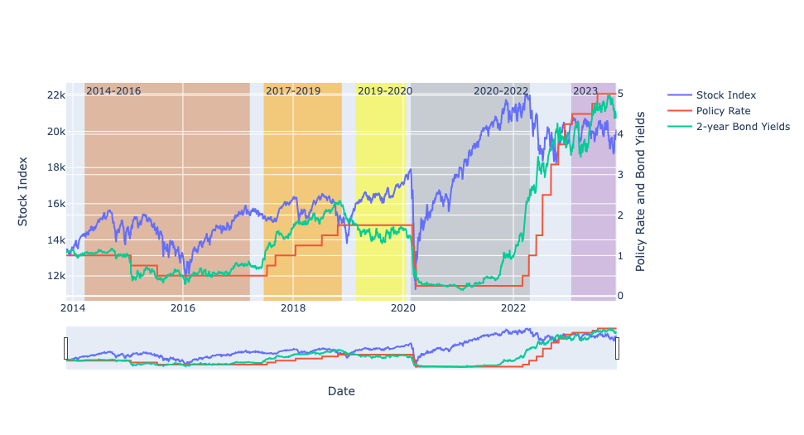
ANALYSIS

Slide 8
FINDINGS
2014-2016:
2016-2019 (Pre COVID):
2019-2020(COVID):
2020-2023:
2023 (Current):
Stock performance rose but fell by 2016.
Bond yield curve was negatively sloped.
Policy rates were falling.
Policy rate started out stable then rose.
Both yield curve and stock index had risen.
Indicates a policy to contain inflationary pressures.
Policy rates held firm.
Yield curve became negatively sloped.
Stock index continued soared & dropped precipitously in 2020.
Policy rates were kept low to stimulate the economy post-COVID.
Short-term bond market and stock market responded positively.
Rates continued to rise to 5% an all time high.
Both bond and stock markets responded negatively.
Indicates the onset of a recession.
Investors are choosing to provide liquidity to the central bank's open market operations instead of investing in the bond and stock markets.

Slide 9
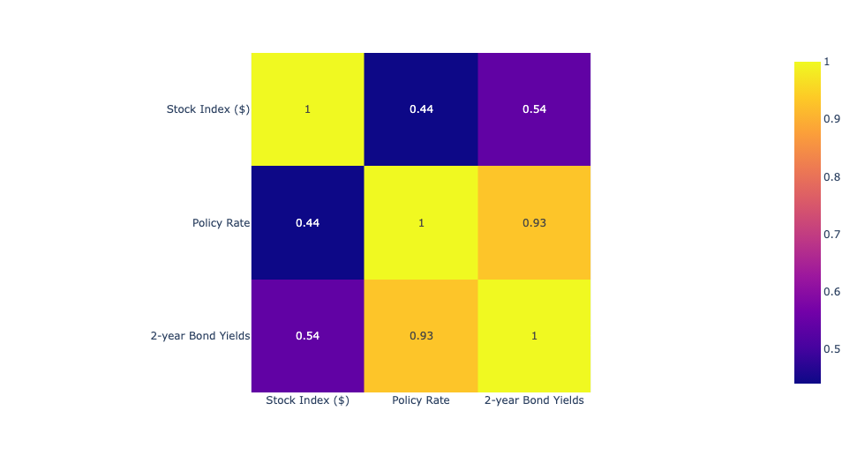
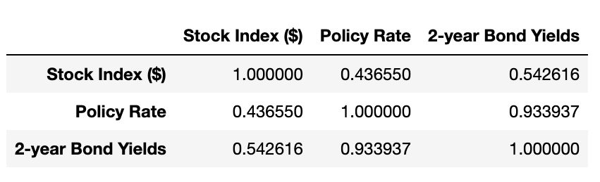
CORRELATION ANALYSIS

Slide 10

CONCLUSION
Stocks and Bonds investors follow the target policy rate.
The Correlation coefficient was 93% for Target Policy and yield curve and 43% stock for stock performance.
The recession led investors to invest in Central Bank Open market Operation instruments
Notes:
The financial market series follow the target policy rate. As rates begin to rise investors make decisions about whether to invest in stocks or bonds.
Correlation coefficient was 93% for yield curve and Target Policy rate whereas for Target policy rate and stock performance it was 43%. Suggesting the relationship is strongest for yield curve and policy rate. Bond investors are attentive to movements in the policy rate than are stock investors..
Once the economy fell into a recession investors choose to invest in Central Bank Open market Operation instruments and as a result we see both the short term yield curve and the stock index moving in the same negative direction.

Slide 11
WRAP UP
CHALLENGES:
Retrieving data from multiple pages
Inputting information not available to interact with Selenium
Handling error generated by not clickable element
Time period not reproducible
Data clean up(changing data types etc.)
NEXT STEPS:
Stationarity testing
Comparison with time series from US
Volatility modelling
Notes:
Introduce steps for Stationarity testing
To involve time series from US to compare similarities and differences that monetary policy has on both countries.
Volatility modelling.

Slide 12

THANK YOU

